Slide 1
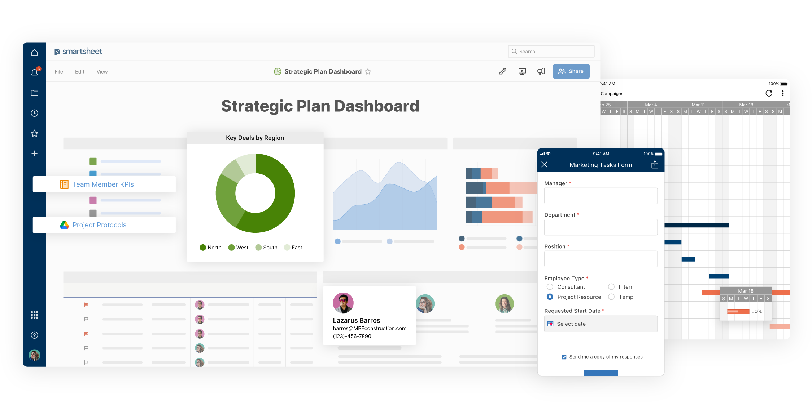
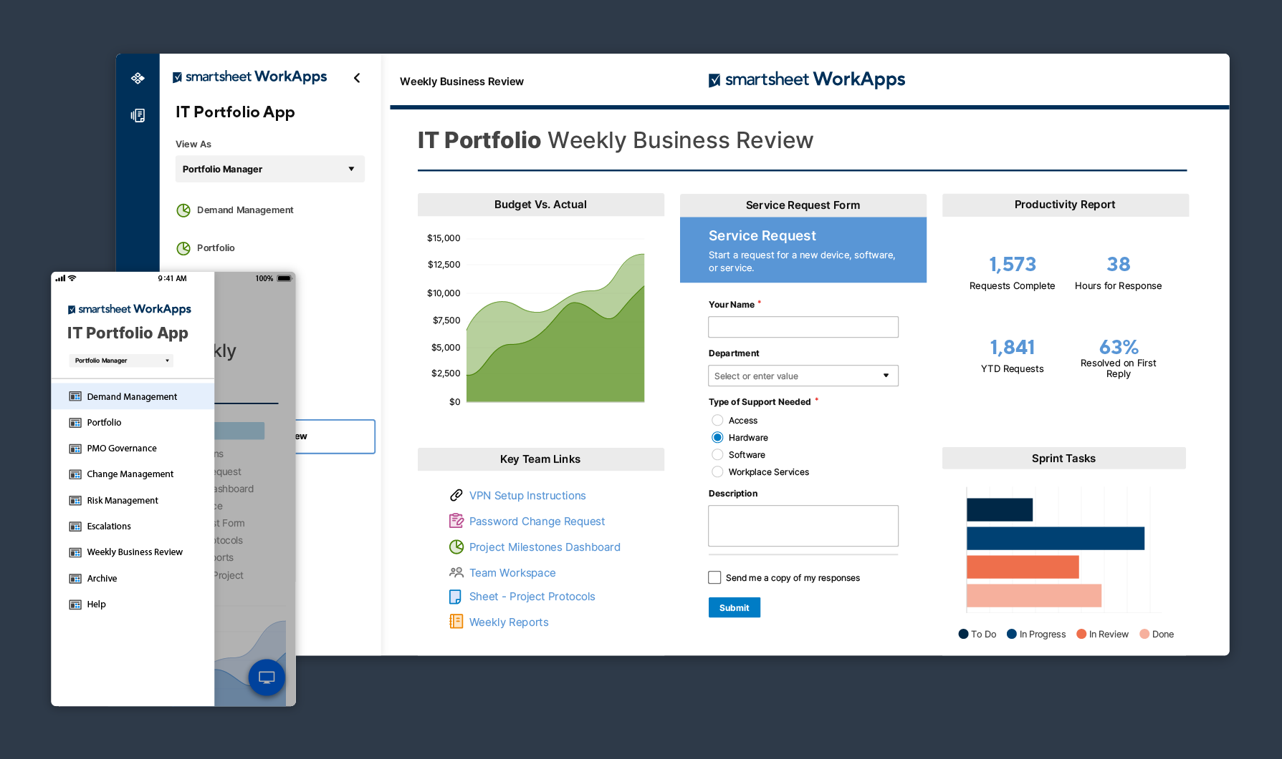
PROBLEM DESCRIPTION AND JUSTIFICATION
PROBLEM VALIDATION

Slide 2
PROBLEM DESCRPTION & PROBLEM VALIDATION
Many of them using online platform to study and do their works. (online submissions, exams and works)
Online users are using Wi-Fi router for access the internet.
Due to this crisis, most of them facing momentary power cuts – Wi-Fi disconnectivity

Slide 3

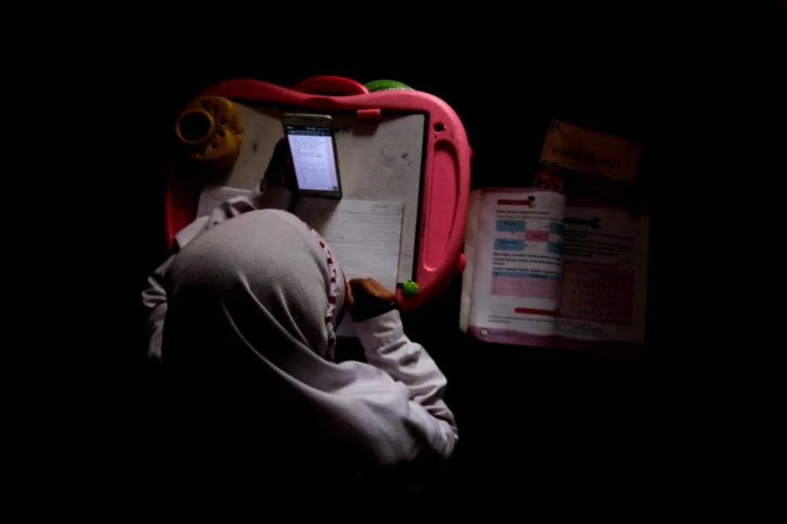
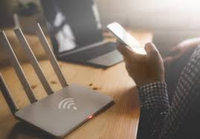
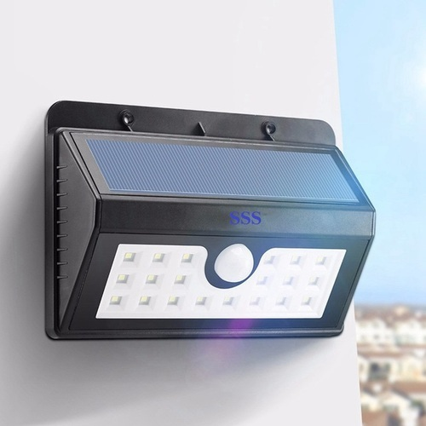
Difficulties faced in momentary power cuts
Can’t attend the online classes properly.
Can't attend online examinations, can't do online submissions instantly.
Solution …
Want a automatic Wi-Fi system for about 3- 4 hours
Use both solar and A/C power to charge the battery
We prefer LED system to system during power cut times
Make device with a manageable cost

Slide 4
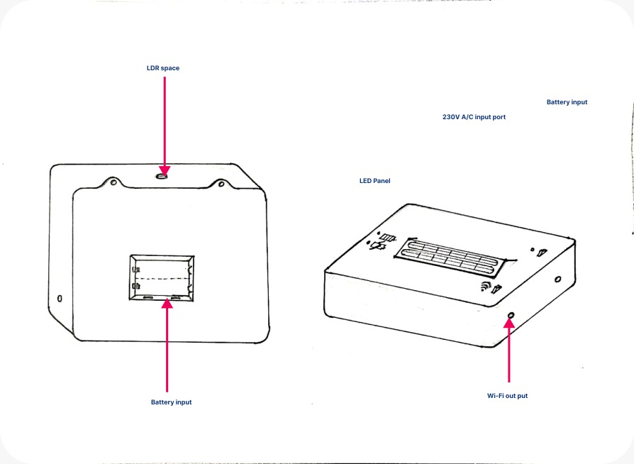
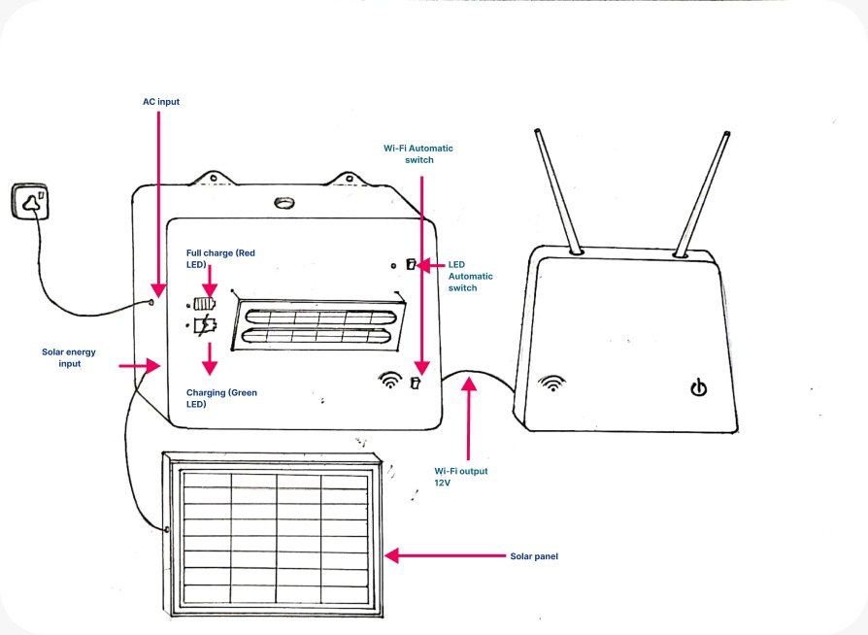
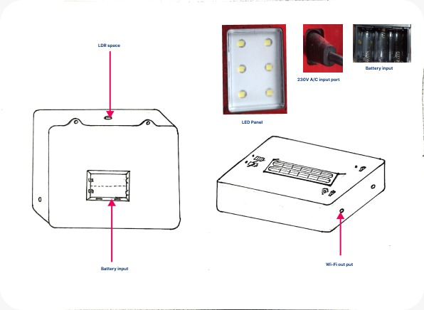
Product interface design

Slide 5
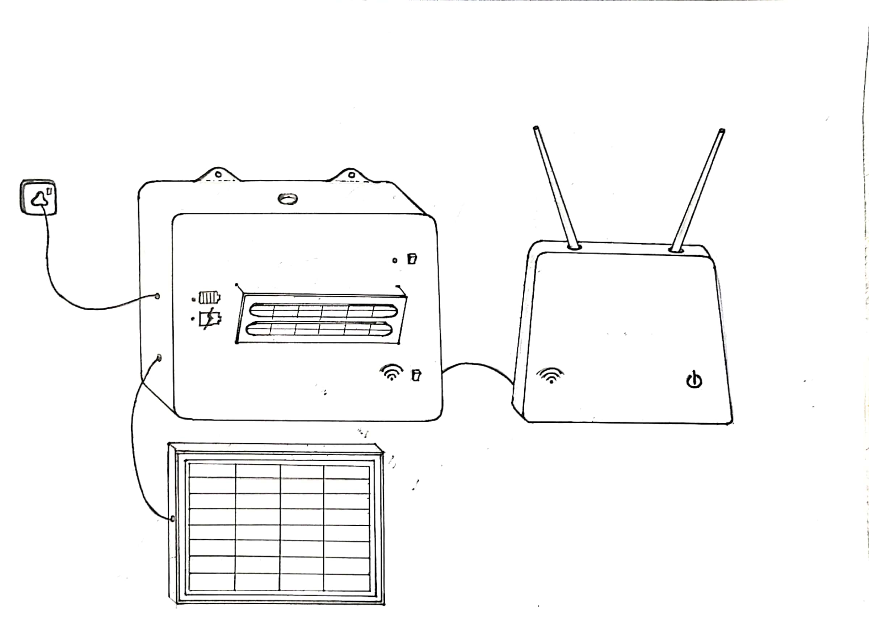
Product features
Real time working
Efficient power providing and easy to handle
Can using automatically and manually
Charging time 2 hours
Warranty
1 year
Working time- 4 hours
Power Consumption 5W
Weight 300g
Height 6cm
Length 8cm
Width 4cm
Life time
4-5 year

Slide 6
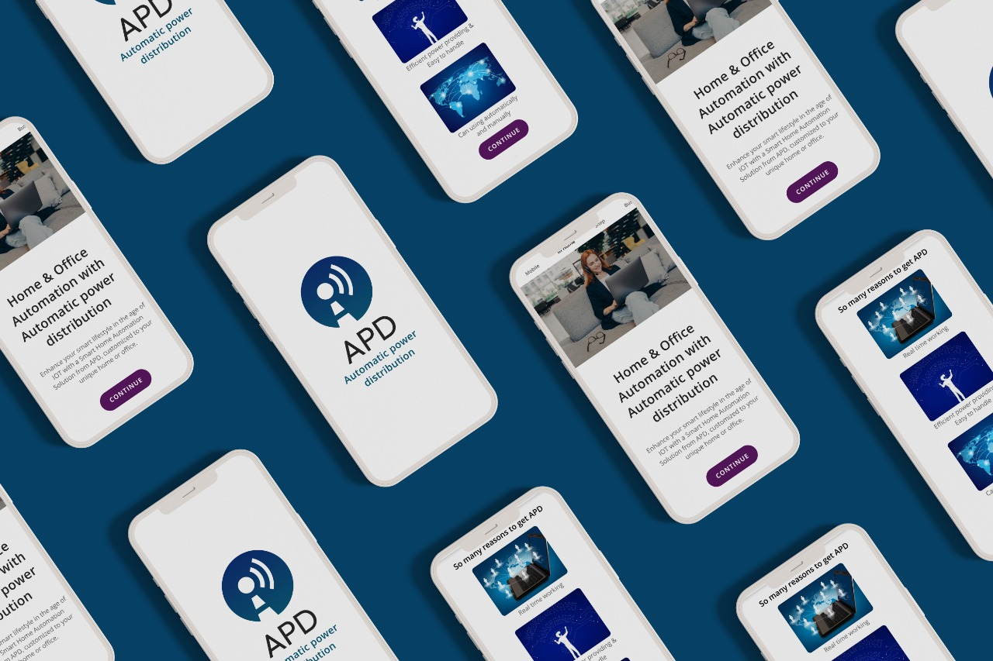
UI Design
Home & office automation with automatic power distribution
Ui design includes..
About the device
how to work with device
Configuring the device
How long It works
Pupose of switch

Slide 7

TECHNICAL & ECONOMIC FEASIBILITY
MARKETING, SALES & BEYOND

Slide 8
TECHNICAL & ECNOMIC FEASIBILITY
Feasibility is the first step toward the process of project design
The technical and economic feasibility define the financial analysis of product design.
First, our simple solar Wi-Fi design involves development of a working model of the product.

Slide 9
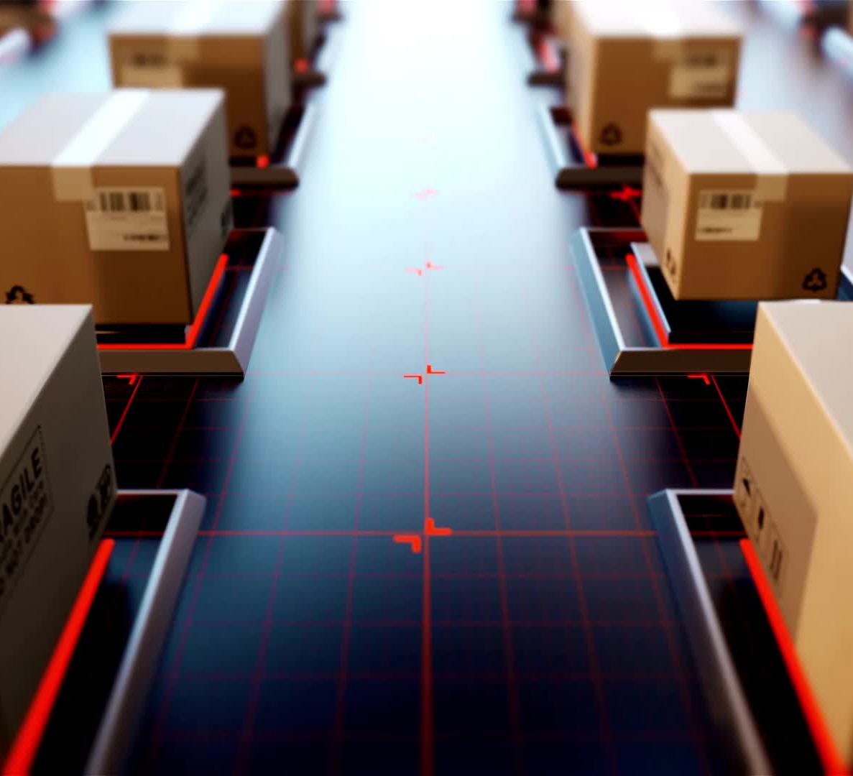
Technical feasibility mainly focus on the present technical resource available in the local market.
We don’t need to bother about the availability of solar Wi-Fi materials and components in the local market.
In the market they are stocked. Because the demand for those materials and components in the market is high.
We are focusing on the technician’s point of view while making the product.
Size of the product
Pollution caused by the product
Production capacity of the product

Slide 10
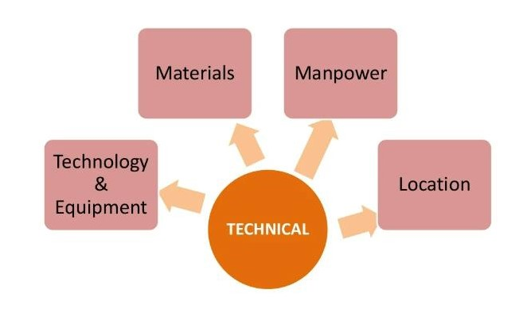

Slide 11

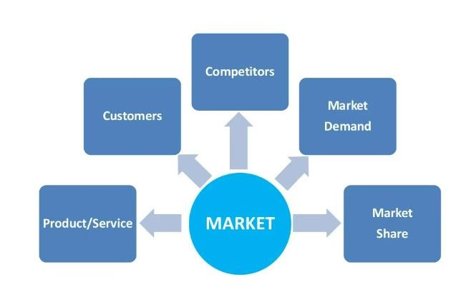
Marketing, Sales & Beyond

Slide 12
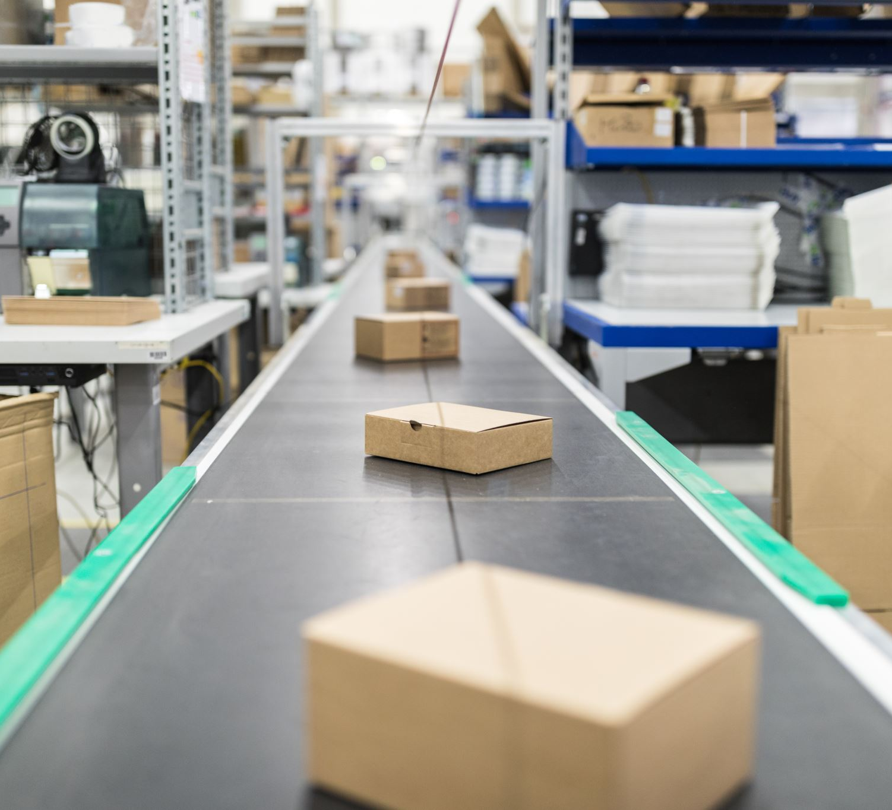
MArKETING, SALES & BEYOND
When we are design a product, we need to ESTIMATE THE DEMAND of that PRODUCT IN THE FUTURE AND ARE THERE ANY ALTERNATE PRODUCT IN THE MARKET. IF THEY ARE MAKE GOOD SIGN TO OUR PRODUCT THEN ONLY, WE CAN EASILY MARKET IN THE MARKET.

